Slide 1
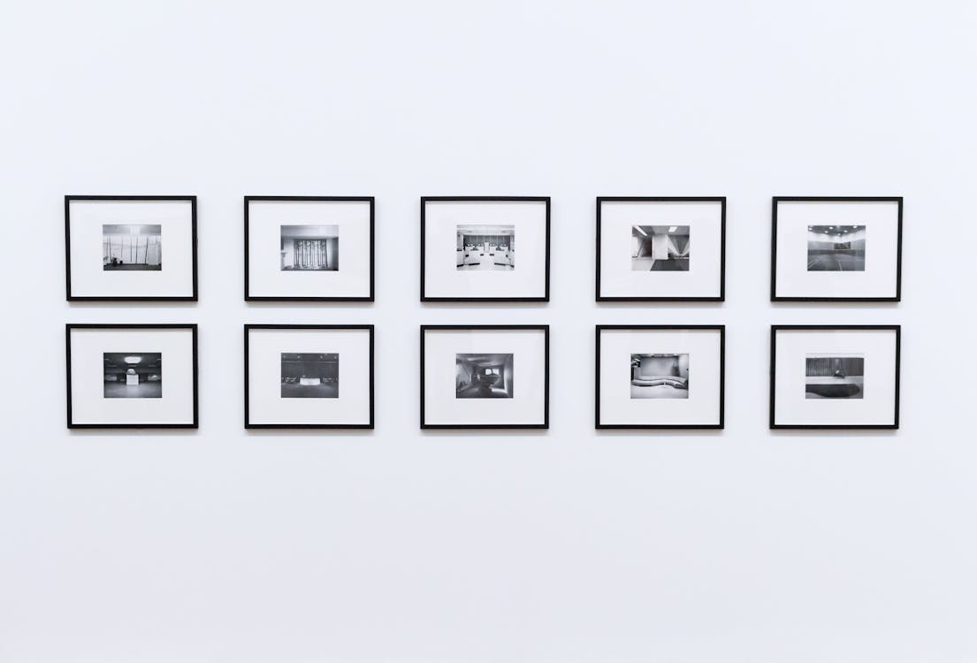
INTRODUCTION TO
REAL LIFE INSURANCE APPLICATION IN
VARIOUS TYPES OF BUSINESSES

Slide 2
We are ready to serve you
COMPANY & BACKGROUND
Evolutis Sdn. Bhd.
Insurance Agency & Consultancy
>20 Years in the Insurance Industry
Previously in the Accounting Profession
Located in Kuala Lumpur, Malaysia

Slide 3
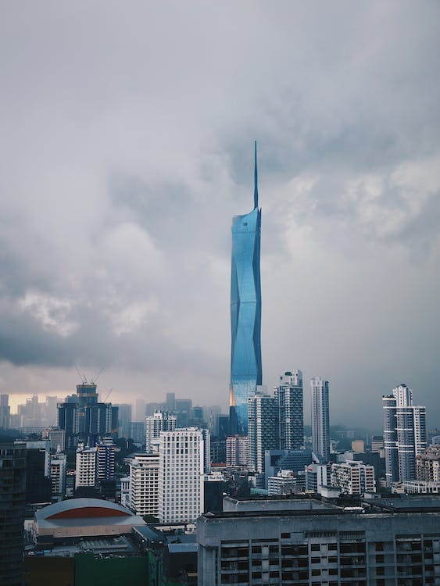
Merdeka 118 is the second-tallest building in the world at 678.9 meters (2,227 ft)

Slide 4
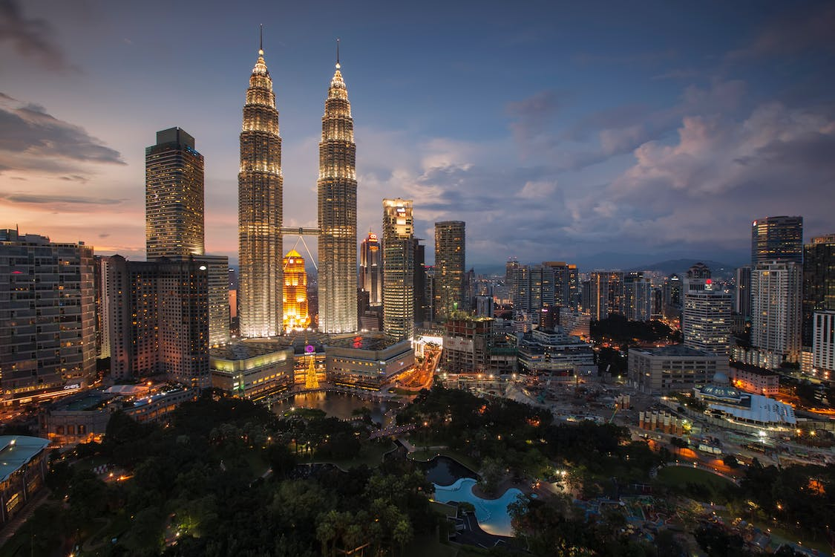
PETRONAS Twin Towers are the tallest twin towers in the world, and its status has remained unchallenged since 1996.

Slide 5
OVERVIEW
BUSINESS CENTRIC
Buildings – Factory, Commercial, Condominiums
Manufacturers – Industrial goods, building materials
Professional firms – Lawyers, Accountants, Engineers
Importers & distributors – F&B, IT & Consumer Goods
Others – Labs, Chiropractor, Retailers etc.

Slide 6
OVERVIEW
SOLUTION CENTRIC
Shareholders insurance
Medical - Duo Location, Digital nomad
Key-person insurance
Employee Benefits – Group insurance

Slide 7
OVERVIEW
CONSULTANCY
Start-up / New Business Model: Insurance requirements & solutions at each stage of the business growth and the road map. E.g. Rent a skateboard
Existing Businesses : Rationalization of existing insurance plans which includes risk management improvement to reduce insurance costs, address insurance gaps and overlaps etc.

Slide 8
INTRODUCTION TO
REAL LIFE INSURANCE APPLICATION IN
VARIOUS TYPES OF BUSINESSES

Slide 9
DISCLAIMER
This video presentation podcast is for general understanding of financial products. It is not intended to offer any financial advice. Viewers are advised to refer to their insurers or financial advisors for further information.
The stories, examples, and illustrations shared reflect the presenters' opinions and experiences, enriching the audience's grasp of discussed concepts. Different financial jurisdictions, institutions and companies have varied terms and conditions for their products and services. Recognizing individual financial situations and needs is crucial; what suits one may not fit another. Due to the evolving financial landscape, thorough research and consultation with qualified advisors before financial decisions are vital.
The content creators doesn't endorse any specific company, financial product, or service mentioned. Viewers are encouraged to exercise their judgment while evaluating financial products/services and seek advice tailored to their needs.
Watching this video implies understanding that its content isn't financial advice; seeking personalized advice from a professional before any financial decisions is crucial. We're not liable for actions taken based on this video's information. Financial decisions involve risks; approach them prudently and with diligence.
Thank you for watching and empowering yourself with financial knowledge

Slide 10
INTRODUCTION TO
REAL LIFE INSURANCE APPLICATION IN
VARIOUS TYPES OF BUSINESSES

Slide 11
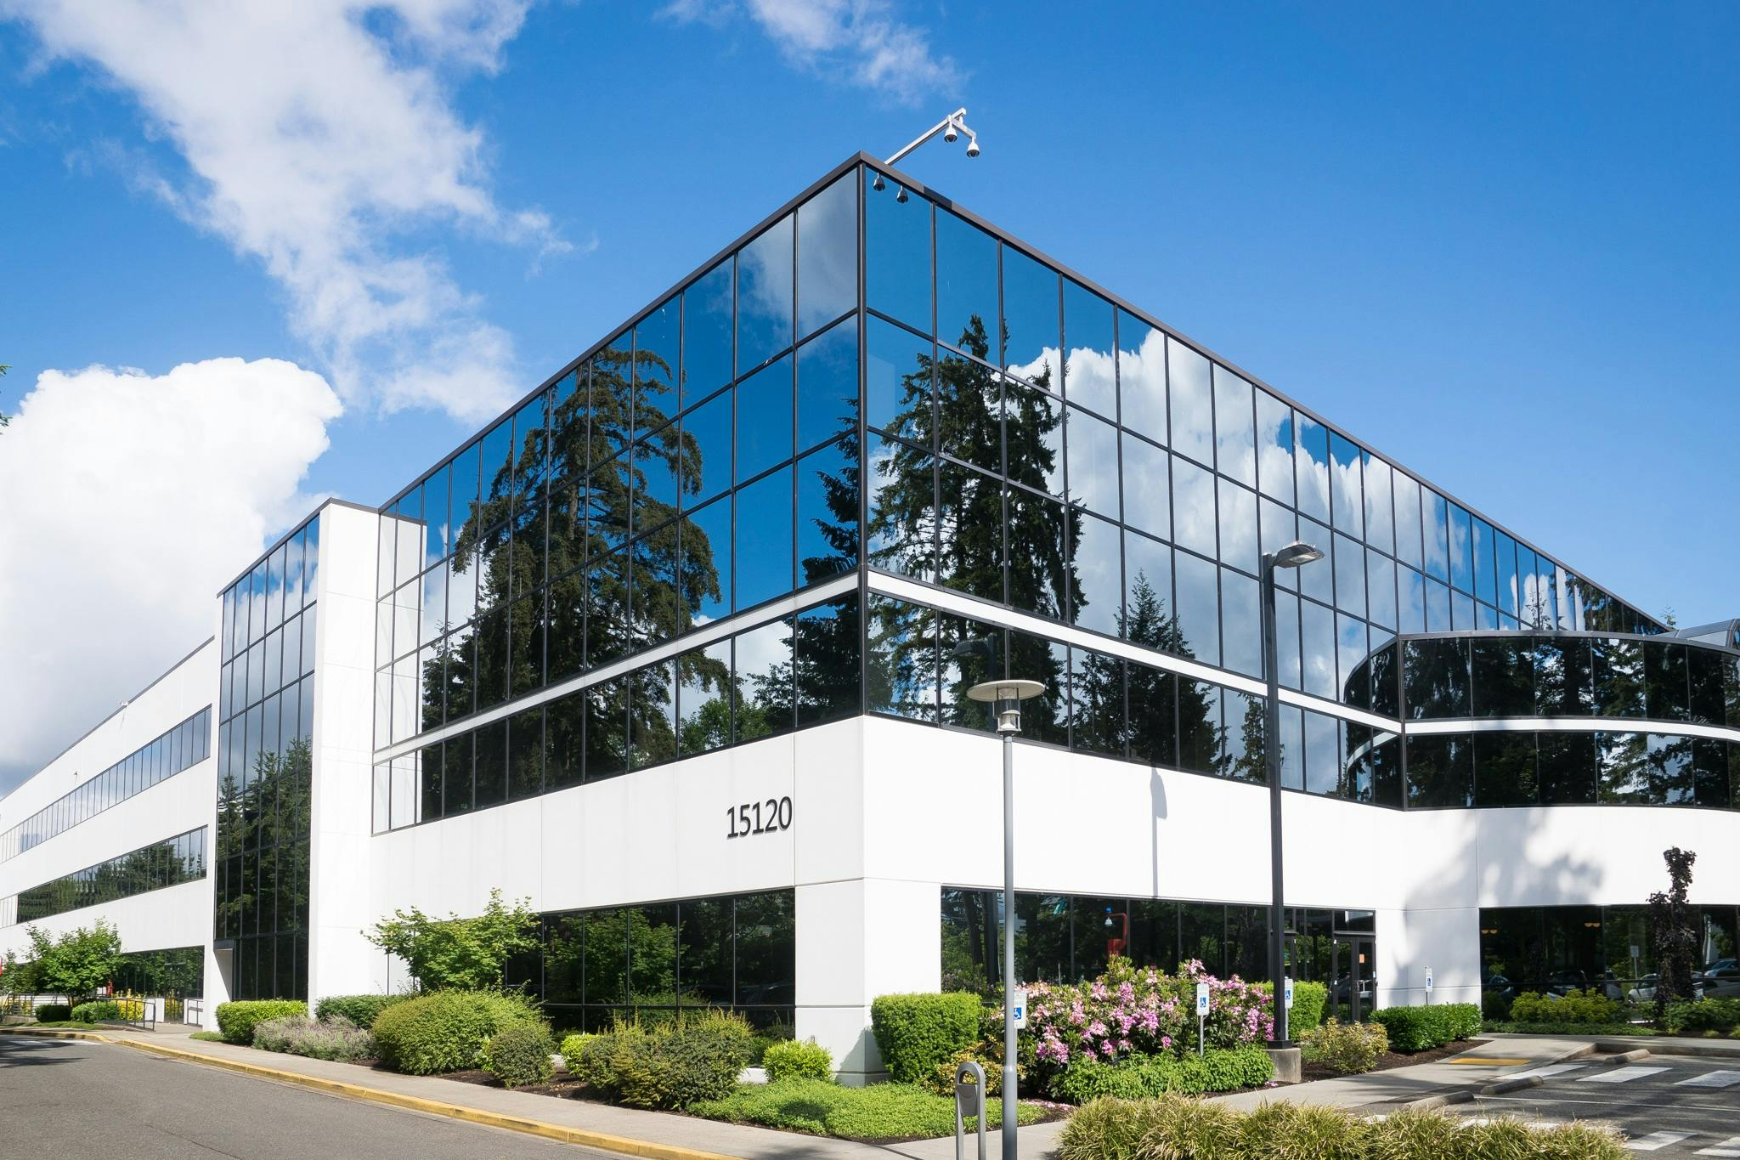
Building What could possibly go wrong?
Property Insurance Fire & Lightning, flood, Windstorm and other perils
Glass breakage
Vandalism
Theft
Have you witness a fire (Hard to stop)
Have you witness a flood ? (Hard to stop)
Liability
Injury & property damage to Visitors / Neighbour / Public

Slide 12
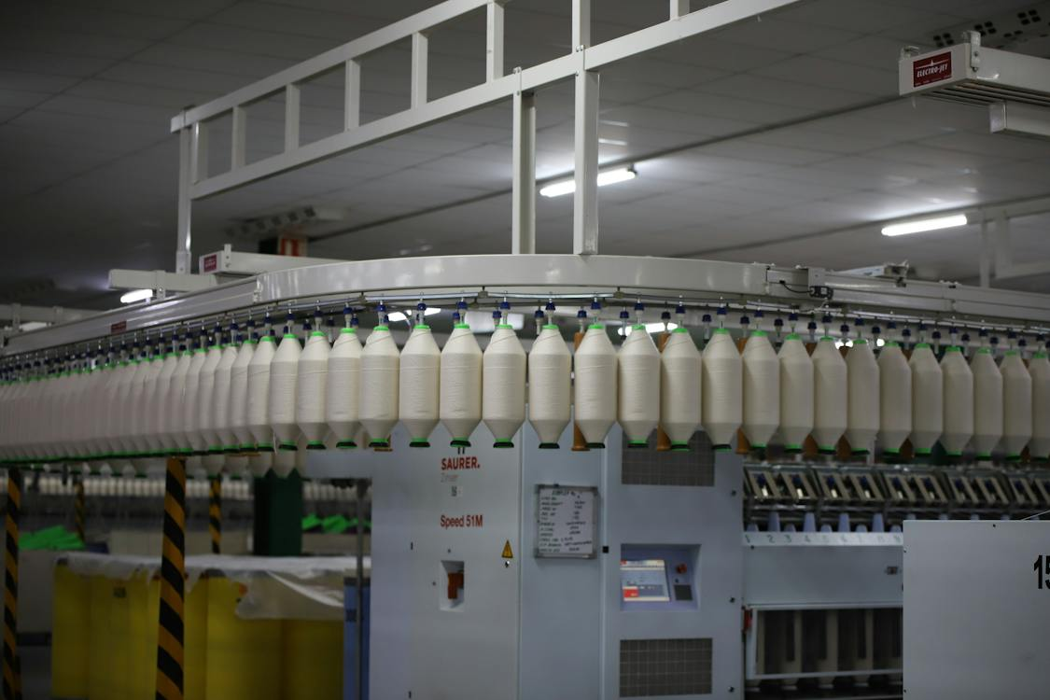
Production What could possibly go wrong?
Machinery Insurance Fire & Lightning, flood, Windstorm and other perils
Burglary, Accidental damage
Business interruption Loss of profits – cancelled orders
increase in costs – outsource
Bills and salary to pay (maybe rent if agreement did not allow)

Slide 13
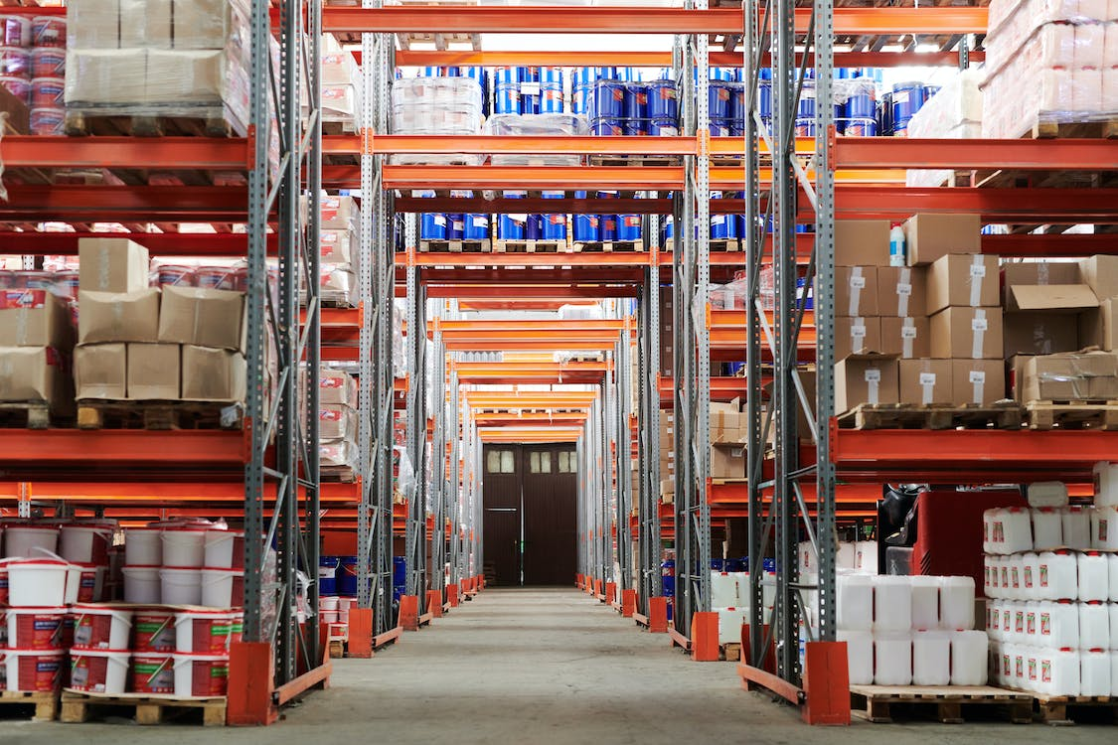
Stocks What could possibly go wrong?
Property Insurance Fire & Lightning, flood, Windstorm and other perils
Burglary – Stolen or damaged
Accidental damage

Slide 14
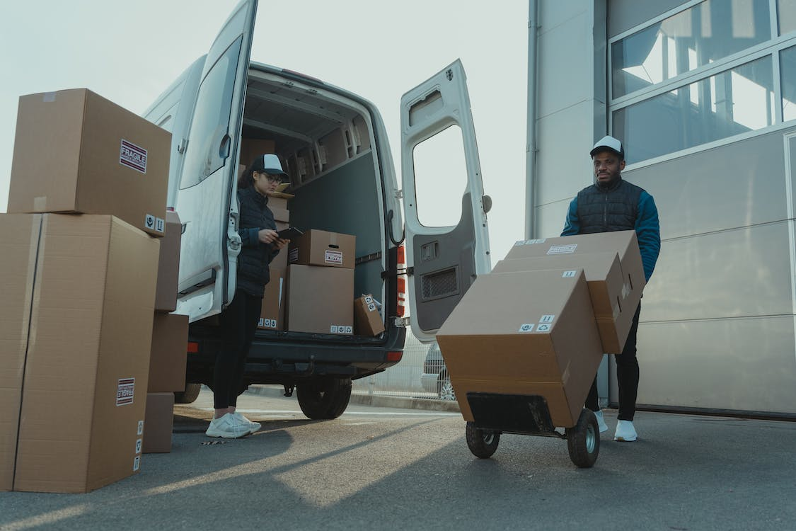
Good in transit What could possibly go wrong?
Property Insurance Accident
Hijack
Theft

Slide 15
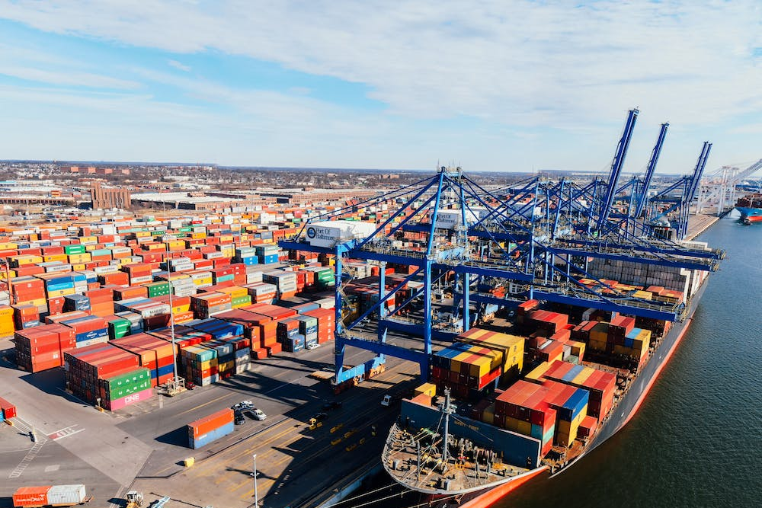
Goods / Cargo What could possibly go wrong?
Marine Insurance Lost / damage during shipment
Jettison – share of losses
Case : Bottles of wine damaged during shipment

Slide 16
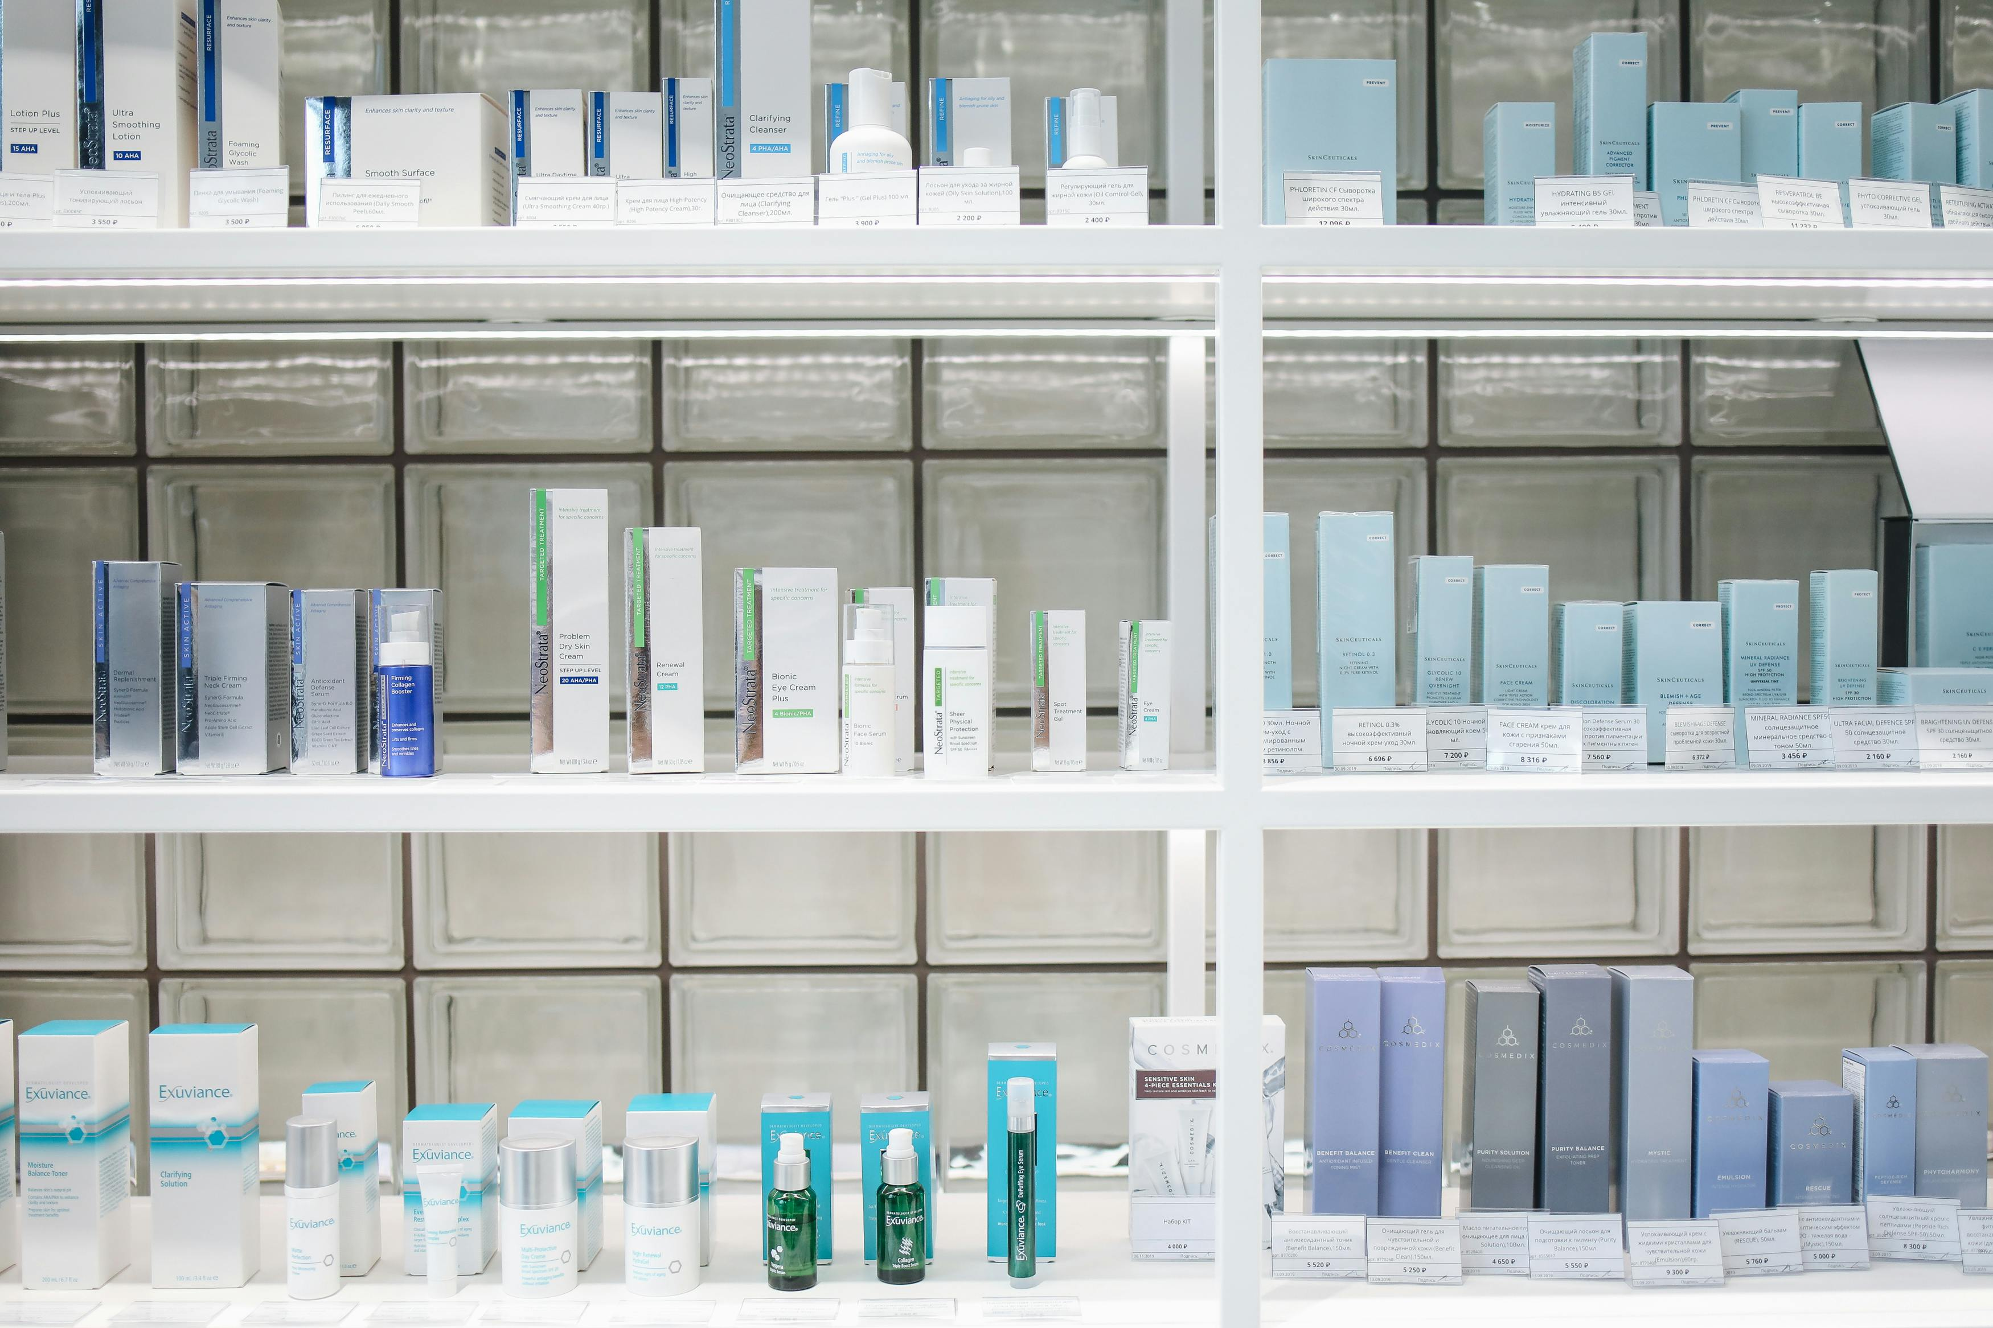
Product What could possibly go wrong?
Product Liability Insurance
*Defective Product
Design, Manufacturing, Labelling
*Caused
Bodily injury or property damage resulting from the use of the product

Slide 17
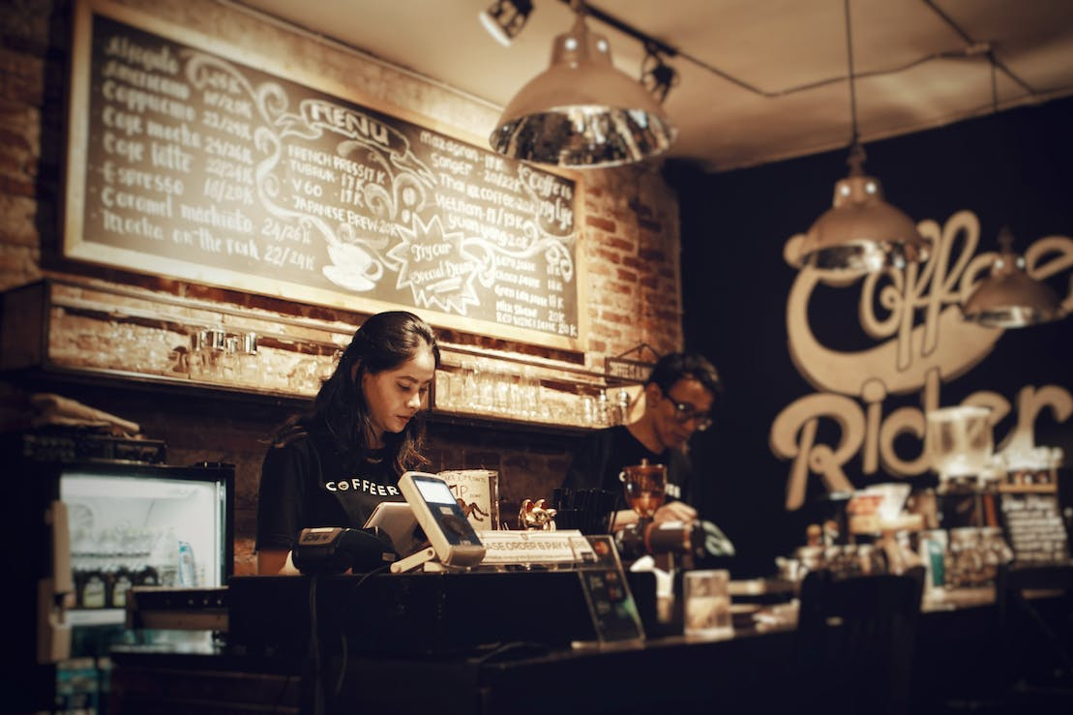
Retail / Café / Store What could possibly go wrong?
Property Insurance
Renovation & equipment, furniture and fittings, stocks
Theft of goods / Vandalism
Liability
Customer injured themselves in the store
Food poisoning after taking the food

Slide 18
Digital Presence What could possibly go wrong?
Liability
Cyber Insurance
- Own damage – hardware, software and database
- Third party – stolen data, intellectual property

Slide 19
Influencers (Social media & content creators)
What could possibly go wrong?
General Liability / Social Media Liability etc.)
Being accused of
Copyright infringement
Misinformation
Defamation - Libel & slander
Giving irresponsible financial advice

Slide 20
Employee What could possibly go wrong?
Health and Accident Medical Insurance – Duo Location / Digital Nomad
Accident Disability
Liability
Employer’s liability Decision Makers Liability Directors & Officers Liability Insurance

Slide 21
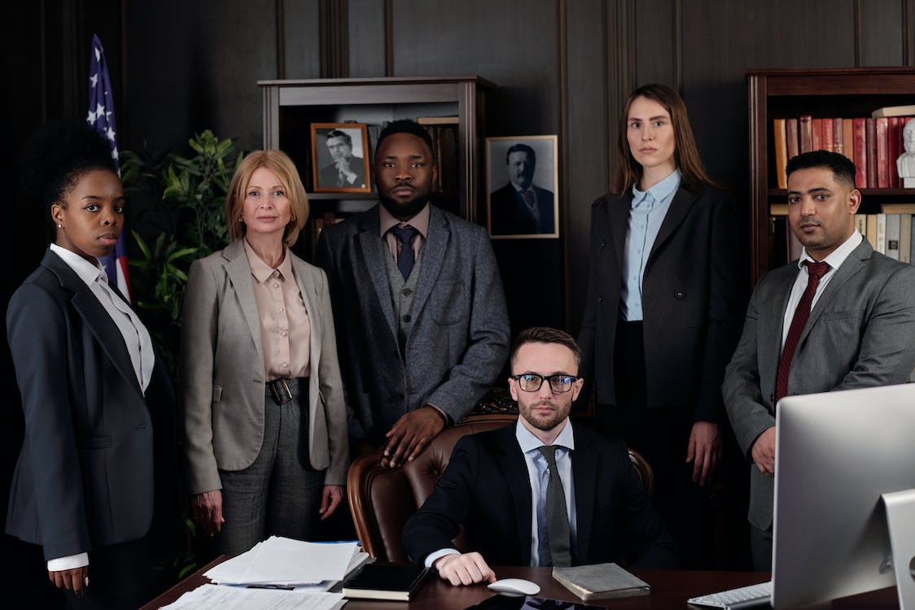
Professionals (e.g. Lawyers, Accountants, Engineers) What could possibly go wrong?
Professional Indemnity Insurance Covers against claims such as
Negligence advice, Breach of confidentiality
Extensions – Defamation, Loss of documents
The benefits include
Legal costs to defend
Damages awarded

Slide 22
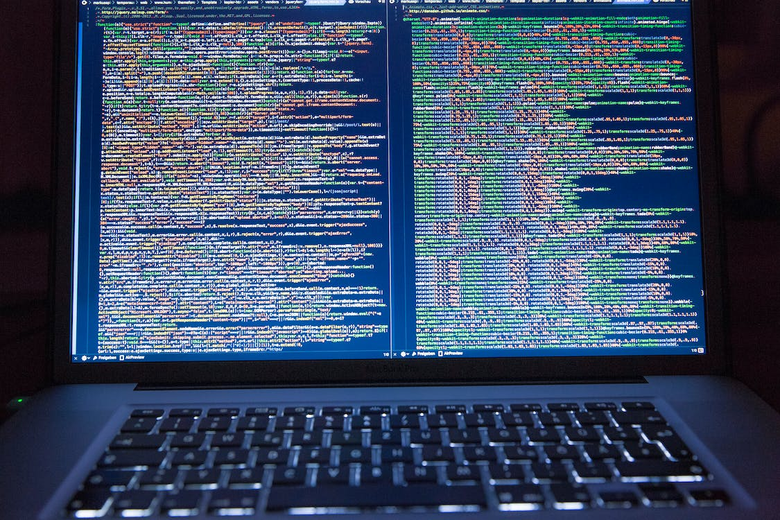
ICT Professionals
Web developer, App Programmers – for clients What could possibly go wrong?
General Liability / ICT Professional Indemnity Insurance Covers against claims on
Negligence & Breach of duty
Being accused of
Missed dateline
Buggy software / Not fit for purpose

Slide 23
Thank You

Slide 24
Questions &
Answers

