Slide 1
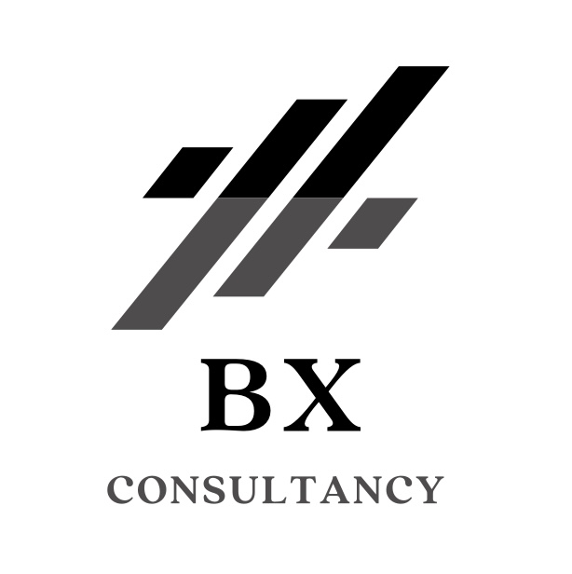
An Hour with a Manager
Pete King
February 2024
Linkedin: petejking

Slide 2
My Background
Born & Educated in the UK. Studied Business at University
Lived & Worked in the UK, Switzerland & The Balkans
First role after university was for the Swiss Company – Zurich, joining their graduate scheme
I have worked for Insurance Companies & Brokers with my last role for the American Multinational Company - AIG leading their operations across Central & Eastern Europe
During Covid’s 1st lockdown, I decided I wanted to set up my own business focusing on Finance with a particular focus on the Start-up Ecosystem working with Insurtech & Overall FinTech

Slide 3
What are Employees Look for?
Work-Life Balance:
Encourage flexible work hours and remote work options.
Implement policies to prevent burnout and support mental health.
Professional Development:
Provide continuous training and development opportunities.
Establish mentorship programs to foster career growth.
Communication and Collaboration:
Foster open communication channels.
Emphasize teamwork and collaboration to enhance the work environment.

Slide 4
Tools to Consider
Employee Feedback Systems:
Implement regular feedback mechanisms to understand employee needs.
Utilize feedback to make informed decisions and improve processes.
Recognition and Rewards:
Establish a system for recognizing and rewarding employee achievements.
Acknowledge contributions to build a positive and motivating work culture.
Technology and Innovation:
Invest in tools that streamline tasks and reduce administrative burdens.
Leverage technology for remote collaboration and efficient communication.

Slide 5
The Link Between Employee Engagement and Customer Satisfaction
Understanding Customer Needs:
Engaged and satisfied employees are more attuned to customer needs.
Human-centric management fosters a customer-oriented mindset among staff.
Enhanced Service Quality:
Motivated employees are more likely to deliver high-quality services.
Positive work environments contribute to better customer interactions.
Empathy and Relationship Building:
Human-centric management encourages empathy and understanding.
Employees who feel supported are better equipped to build strong customer relationships.
Innovation for Customer Solutions:
Engaged employees are more likely to contribute innovative ideas.
Human-centric approaches fuel a culture of continuous improvement, benefiting customer solutions.

Slide 6
Ask Questions
THANK YOU
Connect on linkedin.com/in/petejking/
Believe in yourself
Don’t be scared to ask for help

